Slide 1
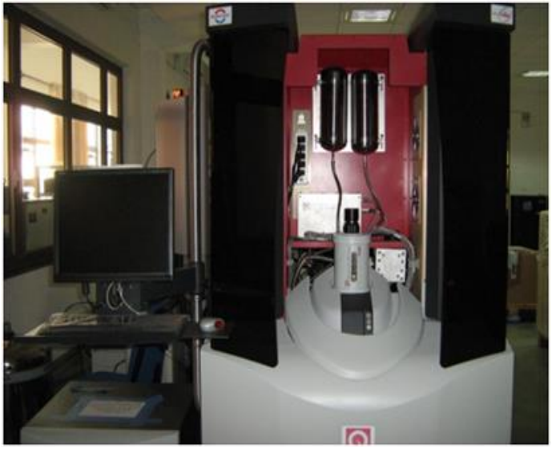
VSM (Vibrating Sample Magnetometer)
Highly sensitive magnetic moment measure device over a range of (1.8 - 400 K) and (7 T)
Sample magnetic field cuts the winding and detects the gradient in terms of current
Flux transformer boost the flux
Prepare the presentation
SQUID converts current into voltage
Works on basic principle
Of Faraday’s law
Detection coil (or) Gradiometer
B field
Sample position
Precise measurement depends on better sample centering
Flux transformer
SQUID with electronics
Notes:
Frequency (?)

Slide 2
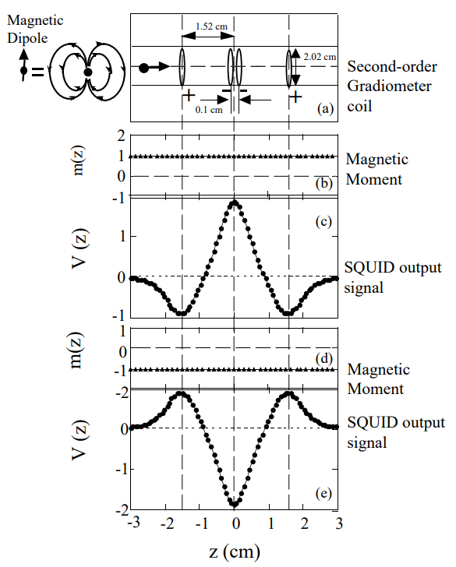
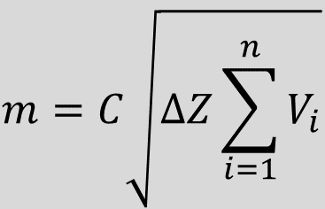


Sample centering
Second-order gradiometer
$$m=C\sqrt{∆Z\sum_{i=1}^{n}{V_{i}}}$$
Magnetic Dipole
$$L$$
$$∆Z=L/(n−1)$$
L = Scan length
n = No. of data points
V_{i} = Voltage reading at i^{th} point
C = Calibration factor
(Current to voltage ratio)
Magnetic moment
SQUID output
signal

Slide 3
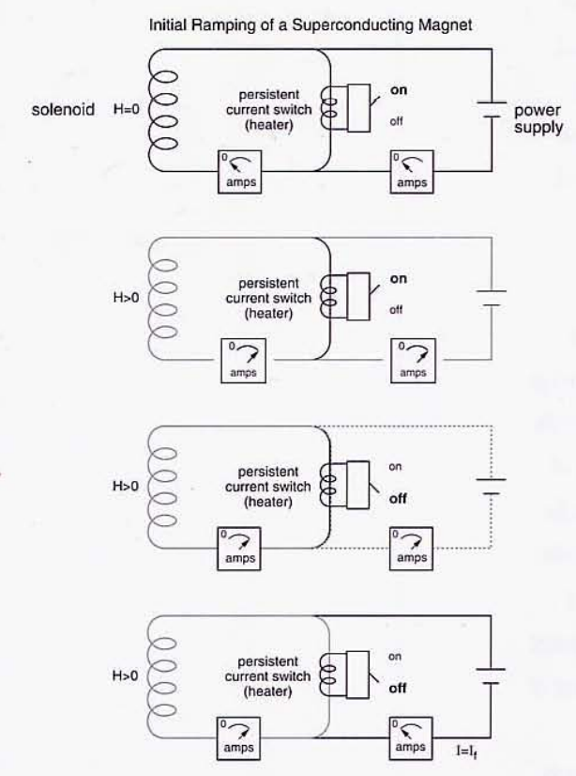
Superconducting magnet
Super conducting magnet wounded in solenoid configuration
Heater ON, Super conducting loop is open
Heater OFF, Super conducting loop is closed
Dewar can evacuated and purged with helium gas
Negligible resistance at less than critical temperature leads, persisting current
Persisting current flows in the circuit

Slide 4
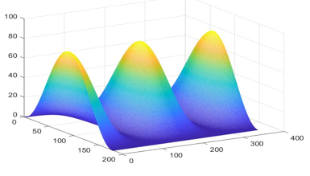
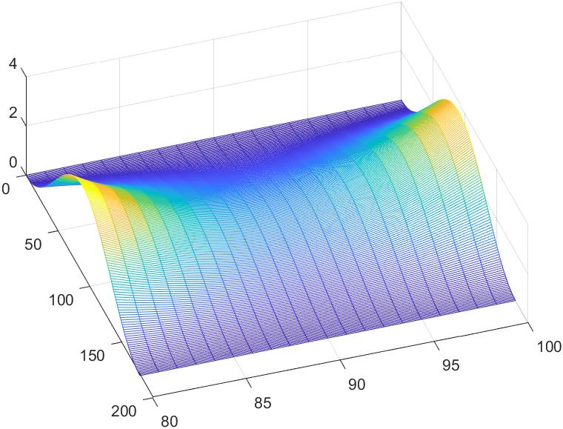



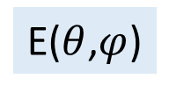
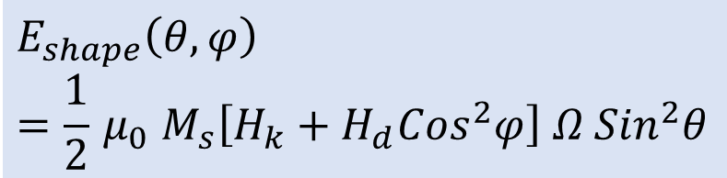
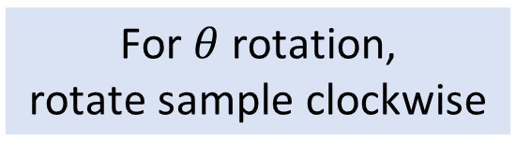




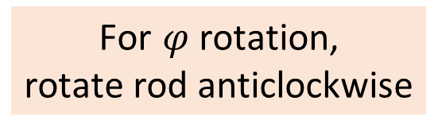


VSM: In-plane rotation
$$E_{shape}\left(θ,φ\right)=\frac{1}{2}{ μ}_{0 }M_{s}\left[H_{k}+H_{d}{Cos}^{2}φ\right] Ω{ Sin}^{2}θ$$
E
E($θ$,$φ$)
$$θ$$
$$φ$$
z
$$θ=0o$$
$$0o≤θ≤{180}^{o}$$
$$φ=90o$$
$$0o≤φ≤{360}^{o}$$
H
z
z
z
z
H
H
H
H
M
M
M
y
M
M
x
y
y
y
y
x
x
x
x
For $θ$ rotation,
rotate sample clockwise
For $φ$rotation,
rotate rod anticlockwise

Slide 5

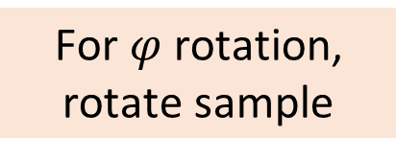


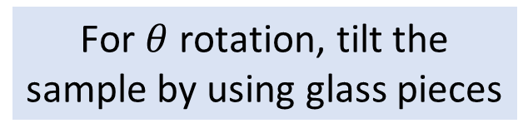





VSM: Out-of-plane rotation
z
E
E($θ$,$φ$)
M
H
$$θ$$
$$φ$$
y
x
$$θ=0o$$
$$0o≤θ≤{180}^{o}$$
$$φ=0o$$
$$0o≤φ≤{360}^{o}$$
z
z
y
y
H
H
H
H
M
z
Focus on this part
y
x
x
M
H
y
x
x
z
z
M
M
y
x
For $θ$ rotation, tilt the sample by using glass pieces
For $φ$rotation,
rotate sample

Slide 6
VSM results

